Slide 1
Driving Scene Segmentation: Lane Detection For Autonomous Car
Team 6: Tejas Mahale, Chaoran Chen, Wenhui Zhang

Slide 2
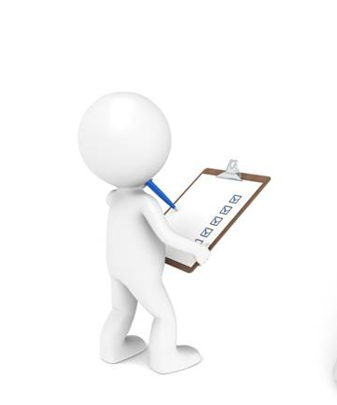
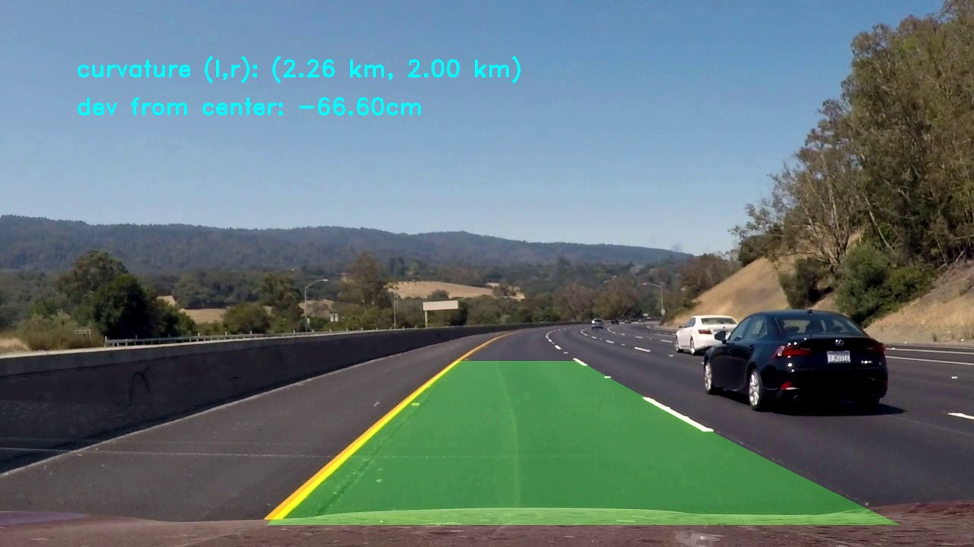
Introduction
The goal of this project is to conduct lane detection in case of quick steering scenario of AutoCars.

Slide 3
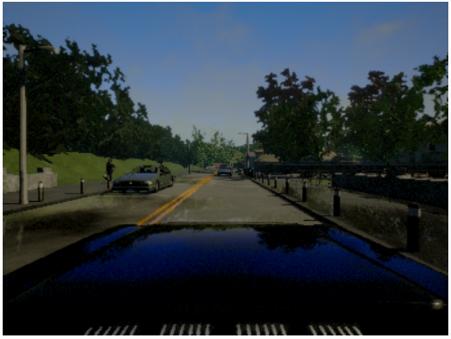
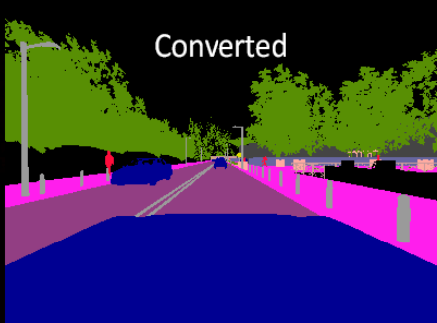
Dataset
Carla simulator dataset
open-source simulator for autonomous driving research
3,000 images along with semantic labels with resolution 600 x 800 x 3
Notes:
Simulation can democratize research in autonomous urban driving. It is also necessary for system verification, since some scenarios
are too dangerous to be staged in the physical world (e.g., a child running onto the road ahead of the car). It is convenient to use the carla simulator to get...

Slide 4
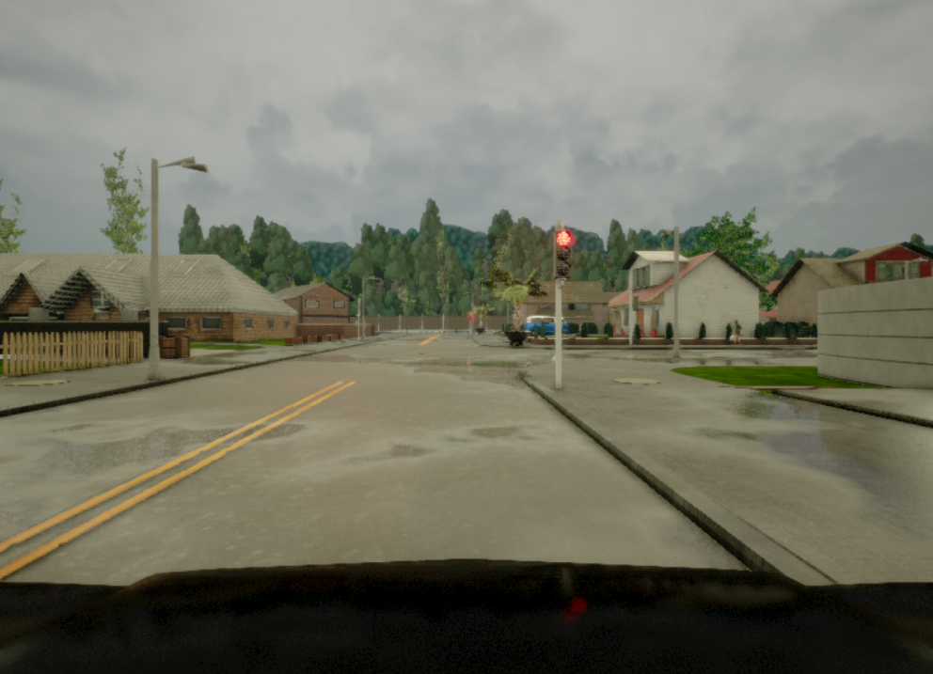
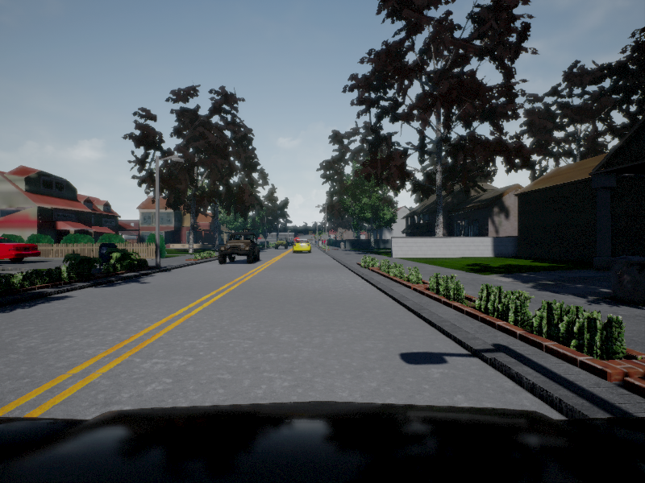
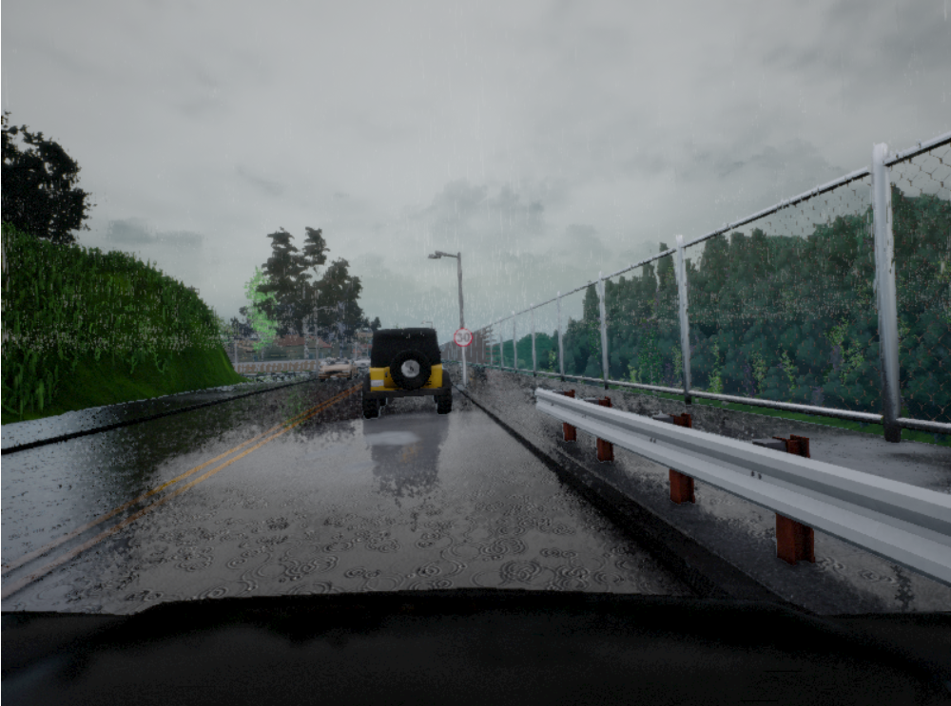
Dataset
Carla simulator dataset
Drive a car in urban conditions to get train images and corresponding encoded label images
Almost all types of weather conditions and different time of day for the images.
Notes:
A wide range of environmental conditions can be specified, including weather and time of day.

Slide 5
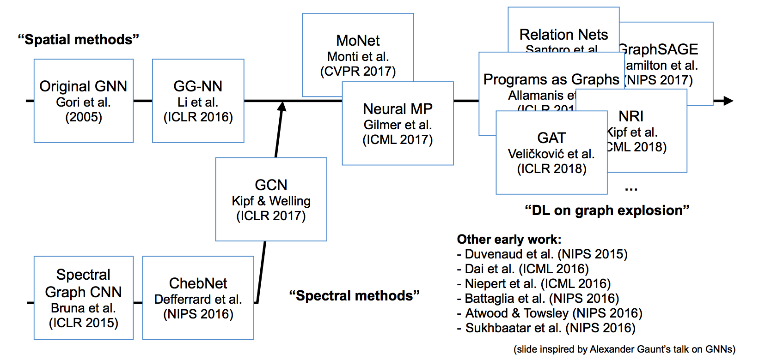
Related Works on Structured DL: Deep learning on graphs etc.

Slide 6

Challenges
1) Classification: object associated to a specific semantic concept
→ use label map with GCN;
2) Localization: classification label for a pixel not aligned with score map
→use camera to world space projection;
3) Noisy Gradient Prediction:
→ use Batch Norm and Boundary Refinement, with optimization method of Adam.

Slide 7

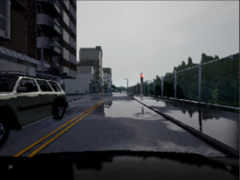
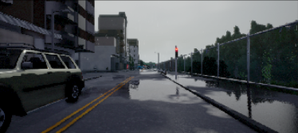
Data Preprocessing
Cropping car hood and sky portion
600 x 800 x 3 360 x 800 x 3

Slide 8
Data Preprocessing
Decodify our depth
R | G | B | int24
00000000 | 00000000 | 00000000 | 0 | min (near)
11111111 | 11111111 | 11111111 | 16777215 | max (far)
To decodify our depth first we get the int24. R + G*256 + B*256*256
Then normalize it in the range [0, 1]. Ans / ( 256*256*256 - 1 )
And finally multiply for the units that we want to get. We have set the far plane at 1000 metres. Ans * far

Slide 9
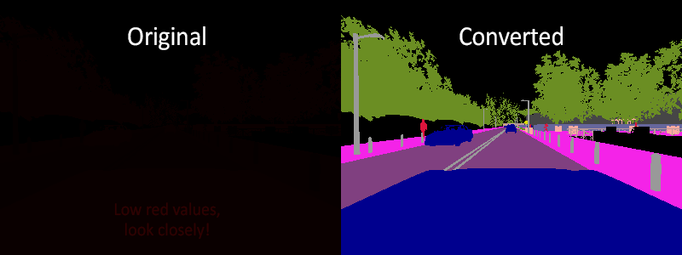
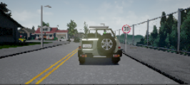
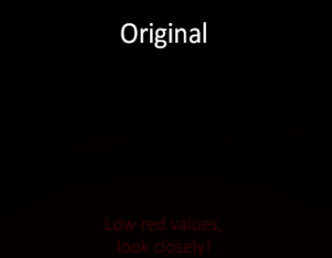
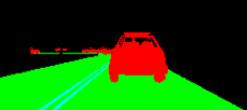
Data Preprocessing
Value | Tag
0 | None
1 | Buildings
2 | Fences
3 | Other
4 | Pedestrians
5 | Poles
6 | RoadLines
7 | Roads
8 | Sidewalks
9 | Vegetation
10 | Vehicles
11 | Walls
12 | TrafficSigns
Encoded image to Segmented image
Every pixel of label image is red channel class label
Retained class labels with road and vehicle and converted them to green and blue respectively

Slide 10
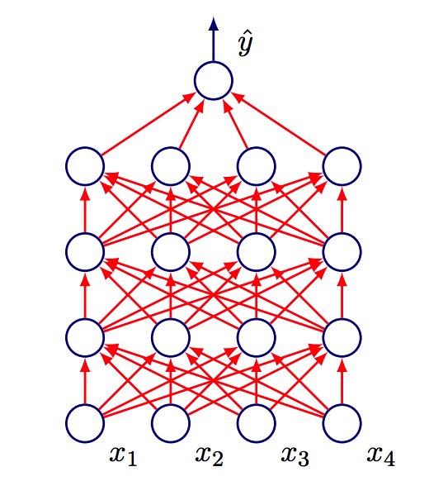
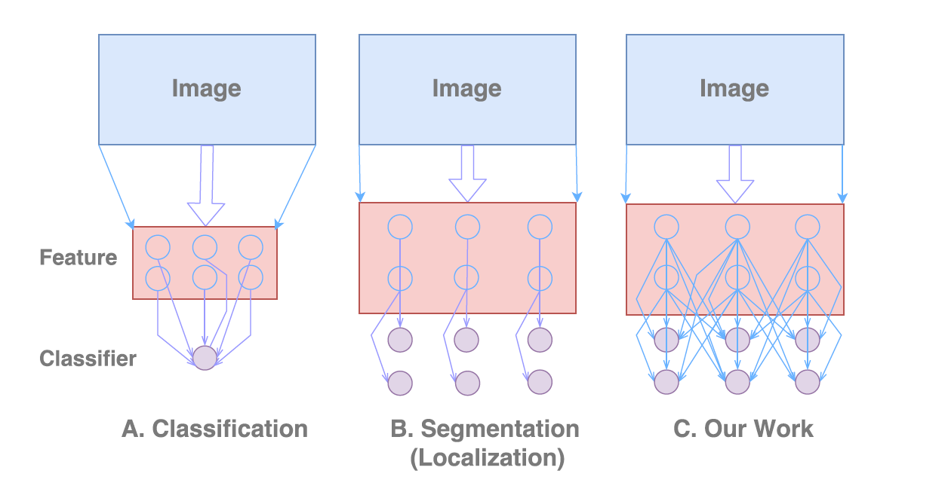
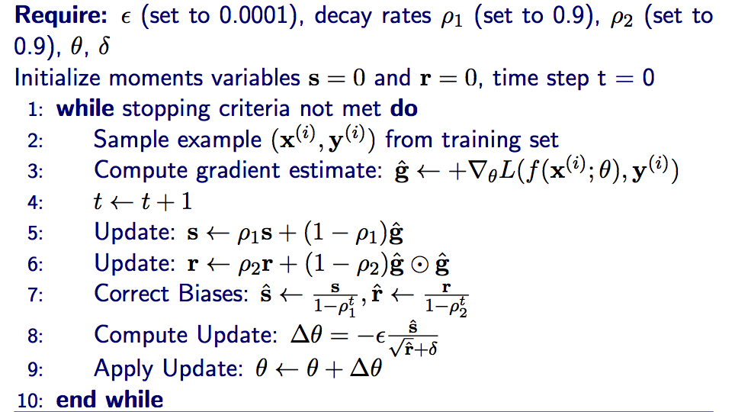
GCN and Adam
Fig 1: Classification network; B: Conventional segmentation network, mainly designed for localization; C: Our Global Convolutional Network.
Fig 2: ADAptive Moments

Slide 11
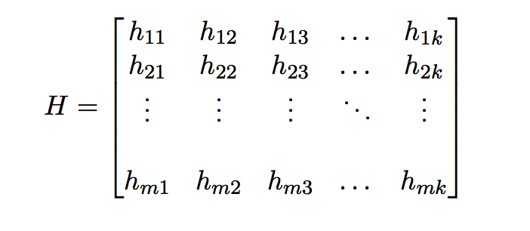
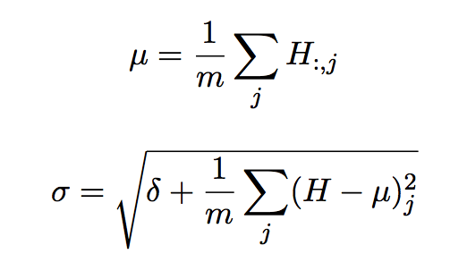
Batch Norm
Reparameterize a deep network to reduce co-ordination of update across layers
Let H be a design matrix having activations in any layer for m examples in the mini-batch
µ is a vector with µj the column mean
σ is a vector with σj the column standard deviation
Hi,j is normalized by subtracting µj and dividing by σj
The new H allows convergence on extremely large datasets

Slide 12
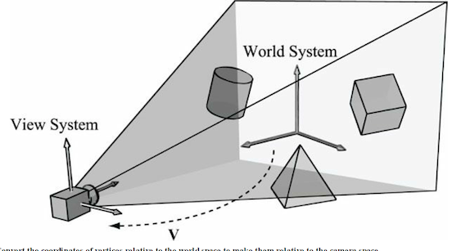
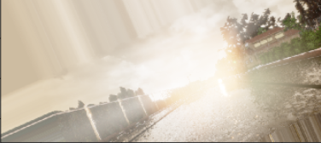
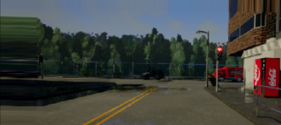
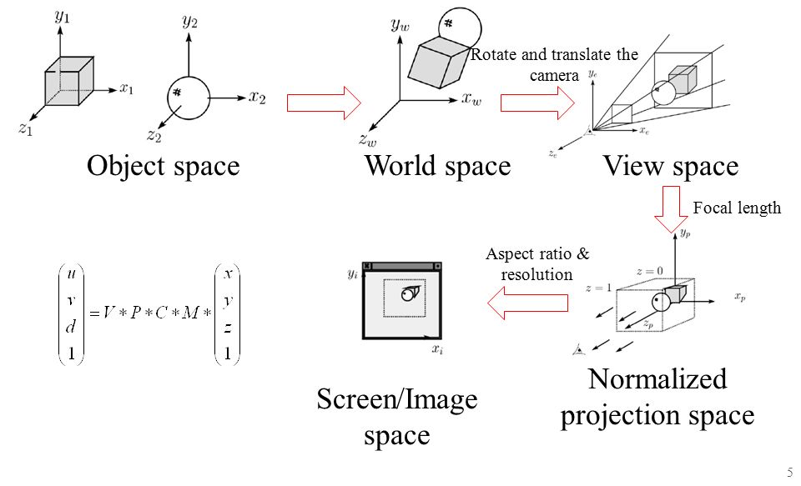
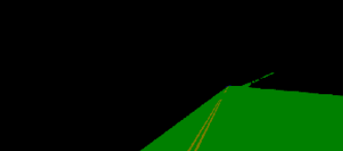
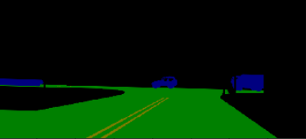
Data Augmentation
Rotation (0, 30 degree) and shifting (Width = (0, 0.2), height = (0, 0.1))

Slide 13
Data Distribution
Training | 2400 images
Validation | 300 images
Testing | 300 images

Slide 14
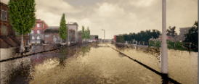
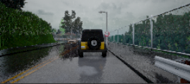
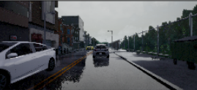
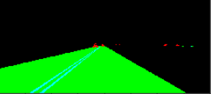
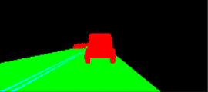
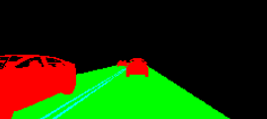
Data Visualisation
The "semantic segmentation" camera classifies every object in the view by displaying it in a different color according to the object class

Slide 15
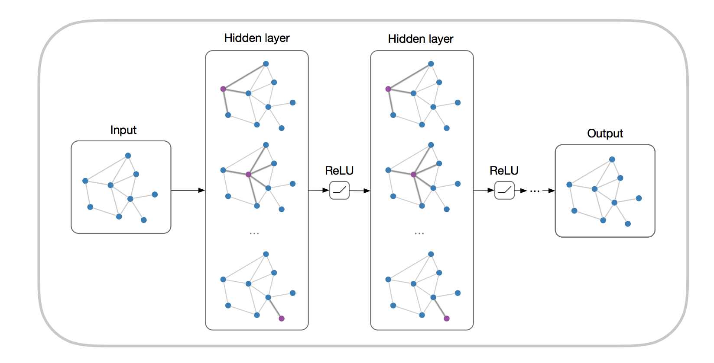
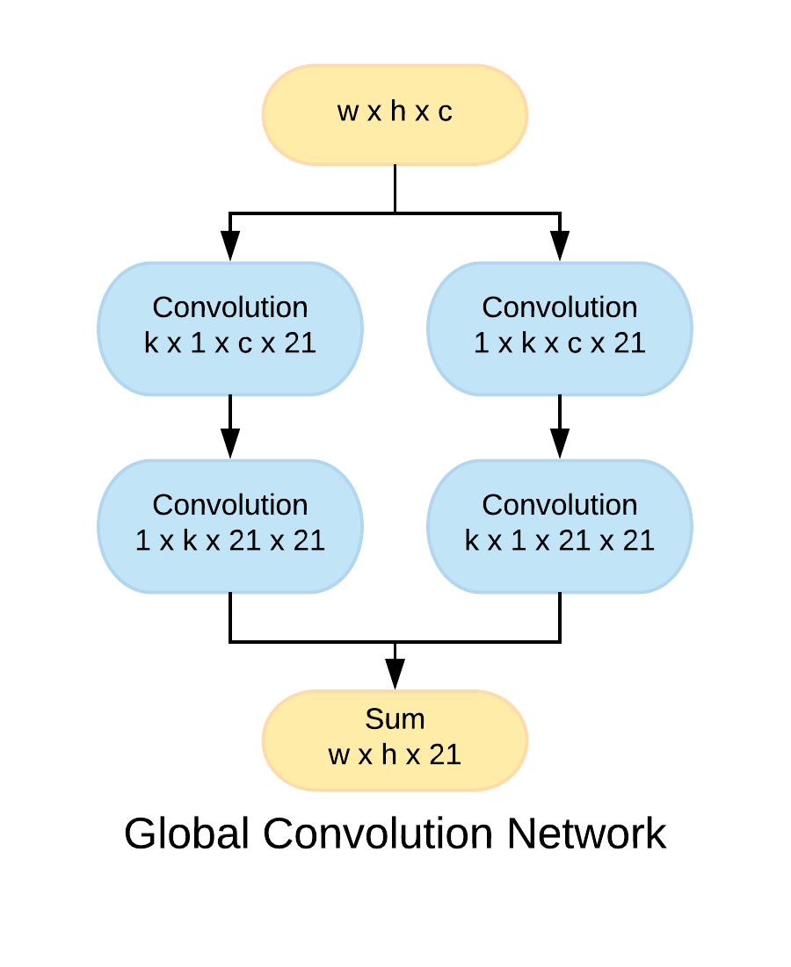
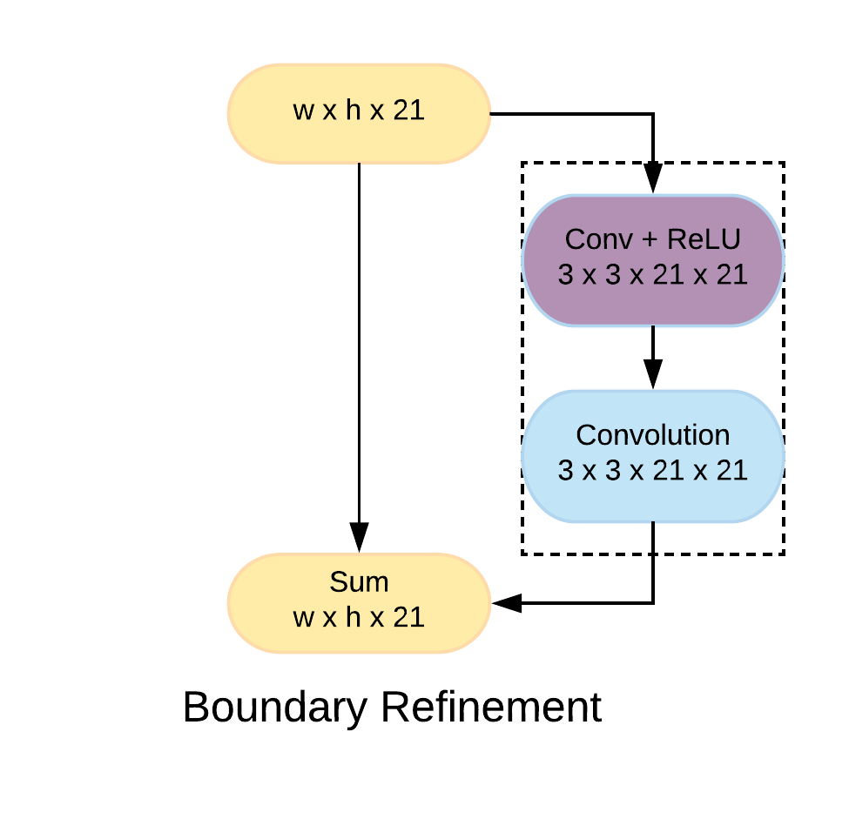
Method : GCN and Boundary Refinement
Metric = RMSE
Notes:
1 x K and K x1 results in K x K kernel with dense connection
Refines segmentation near boundaries

Slide 16
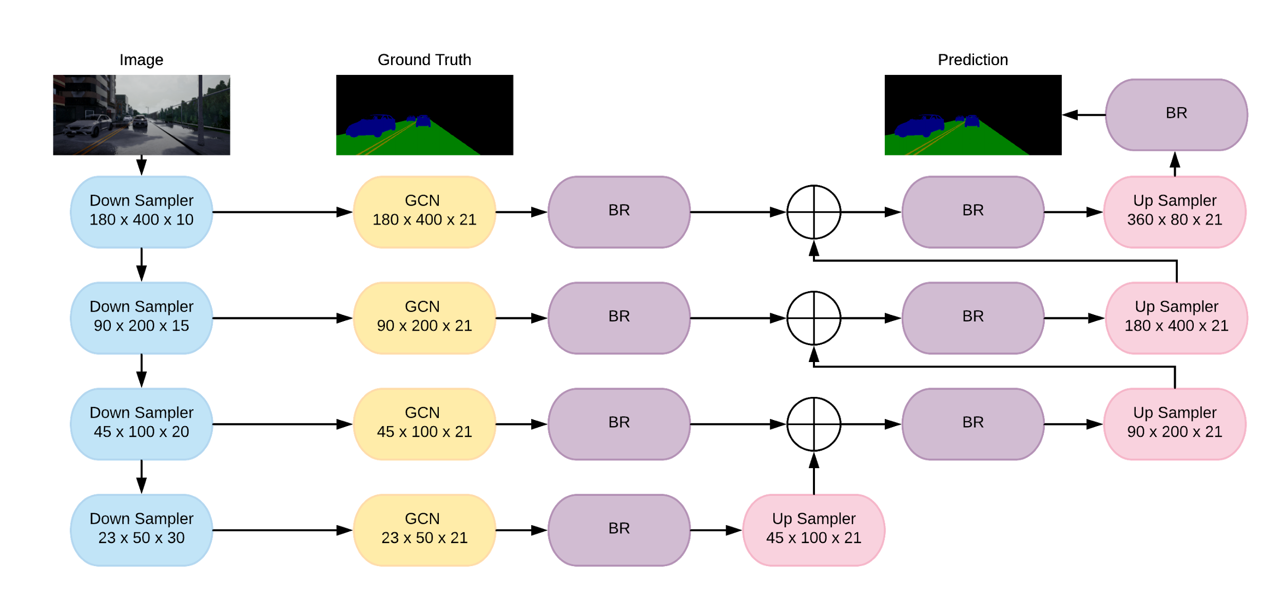
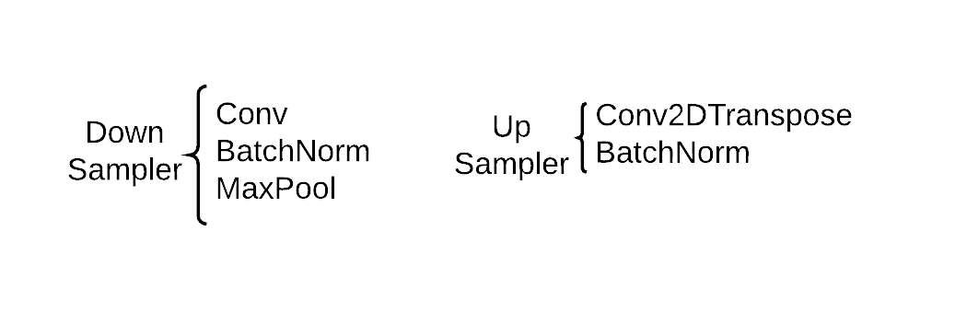
Architecture Model
l

Slide 17
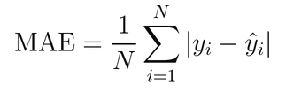
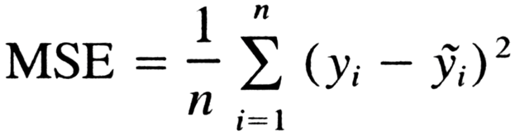
Metric
Mean Absolute Error:
Absolute pixel to pixel difference between two images(in our case ground truth image and predicted image)
Mean Square Error:

Slide 18
Parameters
Parameter | Value
Optimizer | Adam
Learning rate | 0.001
Number of Epoch | 38
Number of Filters | 8, 16, 20, 32

Slide 19

Result
 | Training |  | Validation
 | Minimum Square Error | Mean Absolute Error | Minimum Square Error | Mean Absolute Error
Initial Loss | 1592.1951 | 13.3800 | 1443.7032 | 13.3908
10 Epoch | 192.1637 | 3.1369 | 337.5560 | 6.8221
20 Epoch | 102.3213 | 2.9696 | 119.4761 | 3.7389
30 Epoch | 74.0532 | 2.0202 | 89.0769 | 2.8999
38 Epoch | 42.7771 | 1.7011 | 61.4360 | 2.4999

Slide 20
Result
Results on Test data :
Minimum Square Error | 57.5875
Mean Absolute Error | 2.2104

Slide 21
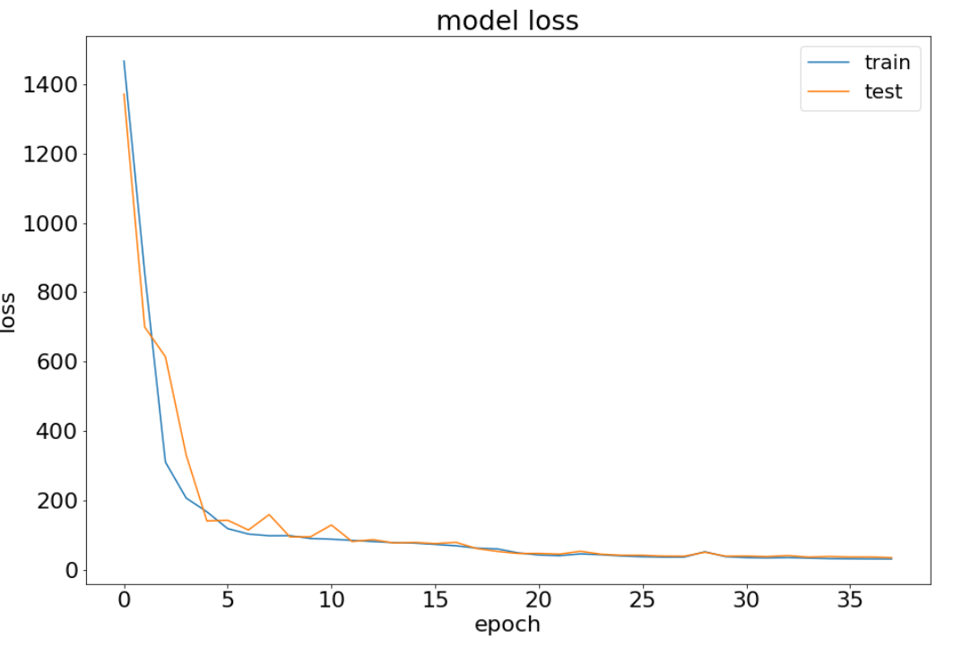
Result

Slide 22
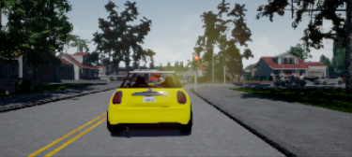
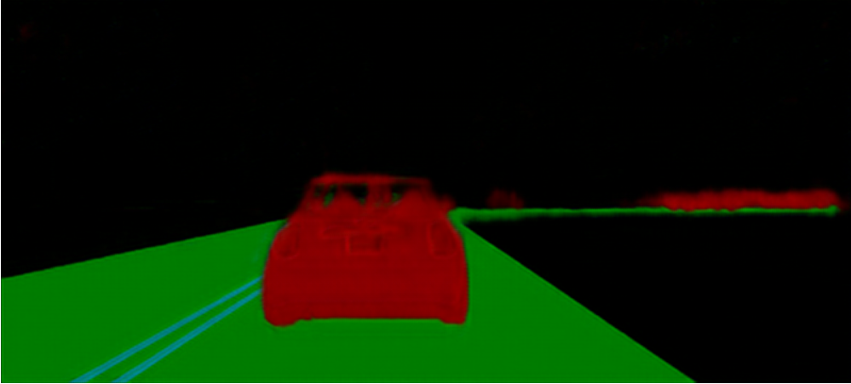
Results
Original Image Predicted image
MSE = 33.1541
MAE = 1.1523

Slide 23
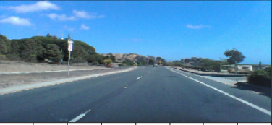
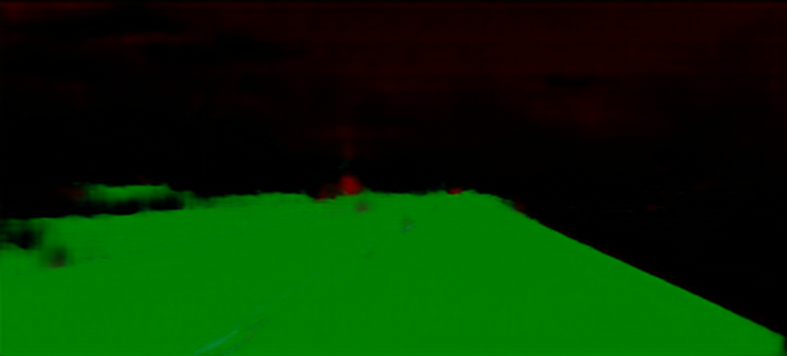
Result

Slide 24
References
[1] Cordts, Marius, et al. “The cityscapes dataset for semantic urban scene understanding.” Proceedings of the IEEE Conference on Computer Vision and Pattern Recognition. 2016.
[2] Geiger, Andreas, et al. “Vision meets robotics: The KITTI dataset.” The International Journal of Robotics Research 32.11 (2013): 1231-1237.
[3] Wang, Panqu, et al. “Understanding convolution for semantic segmentation.” arXiv preprint arXiv:1702.08502 (2017).
[4] Ilg, Eddy, et al. “FlowNet 2.0: Evolution of Optical Flow Estimation with Deep Networks.” IEEE Conference on Computer Vision and Pattern Recognition (CVPR). 2017.
[5] M. Everingham, A. S. M. Eslami, L. Van Gool, C. K. I. Williams, J. Winn, and A. Zisserman, “The Pascal Visual Object Classes challenge: A retrospective,” IJCV, vol. 111, iss. 1, 2014.
[6] Xu, Huazhe, et al. “End-to-end learning of driving models from large-scale video datasets.“IEEE Conference on Computer Vision and Pattern Recognition (CVPR). 2017.
[7] Neuhold, Gerhard, et al. “The mapillary vistas dataset for semantic understanding of street scenes.” Proceedings of the International Conference on Computer Vision (ICCV), Venice, Italy. 2017.
[8] Brostow, Gabriel J., Julien Fauqueur, and Roberto Cipolla. “Semantic object classes in video: A high-definition ground truth database.” Pattern Recognition Letters 30.2 (2009): 88-97.
[9] Oh, Sangmin, et al. “A large-scale benchmark dataset for event recognition in surveillance video.” Computer vision and pattern recognition (CVPR), 2011 IEEE conference on. IEEE, 2011.
[11] Sandipan Narote, Pradnya bhujbal, “A review of recent advances in lane detection and departure warning system” , Volumn 73, Jan 18 Pattern Recognition Elsevier
[12] Ze Wang, Qiang Qiu. “LaneNet: Real-Time Lane Detection Networks for Autonomous Driving”, Computer Vision and Pattern Recognition arxiv.org
[10] Chao Peng, Gang Yu, “Large Kernel Matters-improving semantic segmentation”, CVPR 2017

